Slide 1

Split-It
Team: Brian Sokol, Logan Skinner, Jacob Tucker, Hanlin Ye, Tzofi Klinghoffer

Slide 2
Problem Definition
It can be a real hassle to split costs with friends, roommates, business partners, etc. for things like food expenses, travel expenses, etc. Thus Split-It will simplify the task of determining who owes who what by keeping track of it for you; all you need is your receipts and our app will do the work for you!
Notes:
Jacob

Slide 3
Scope
Support 80% of retail stores
Process receipts using OCR (specifically BlinkReceipt)
Use Twillo and OAuth for user verification
Utilize Azure for our backend implementation
Maintain state between multiple devices and properly handle concurrency

Slide 4
Description
Read receipt data via OCR
Process the data and allow the user to assign items to individuals in a group
Perform calculations on how much each person in a group owes or is owed
Notes:
Brian

Slide 5
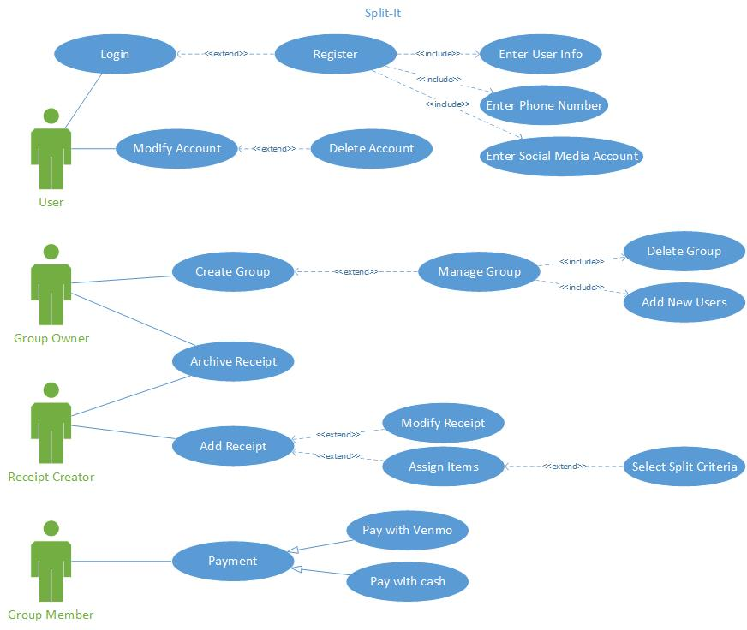
Use Case Diagram
Notes:
Brian

Slide 6
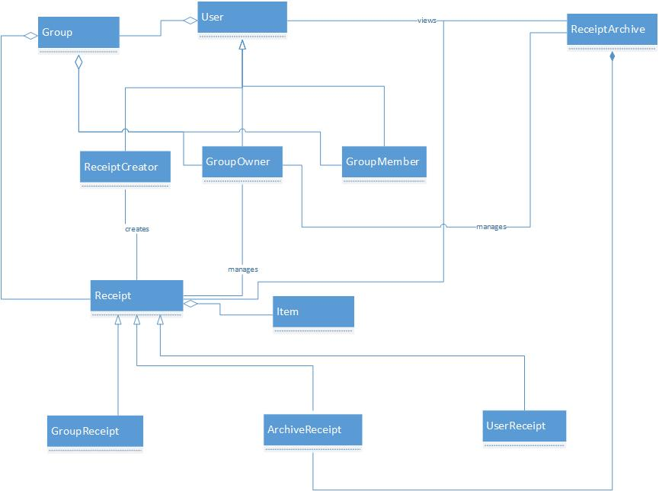
Class Diagram
Notes:
Jacob

Slide 7
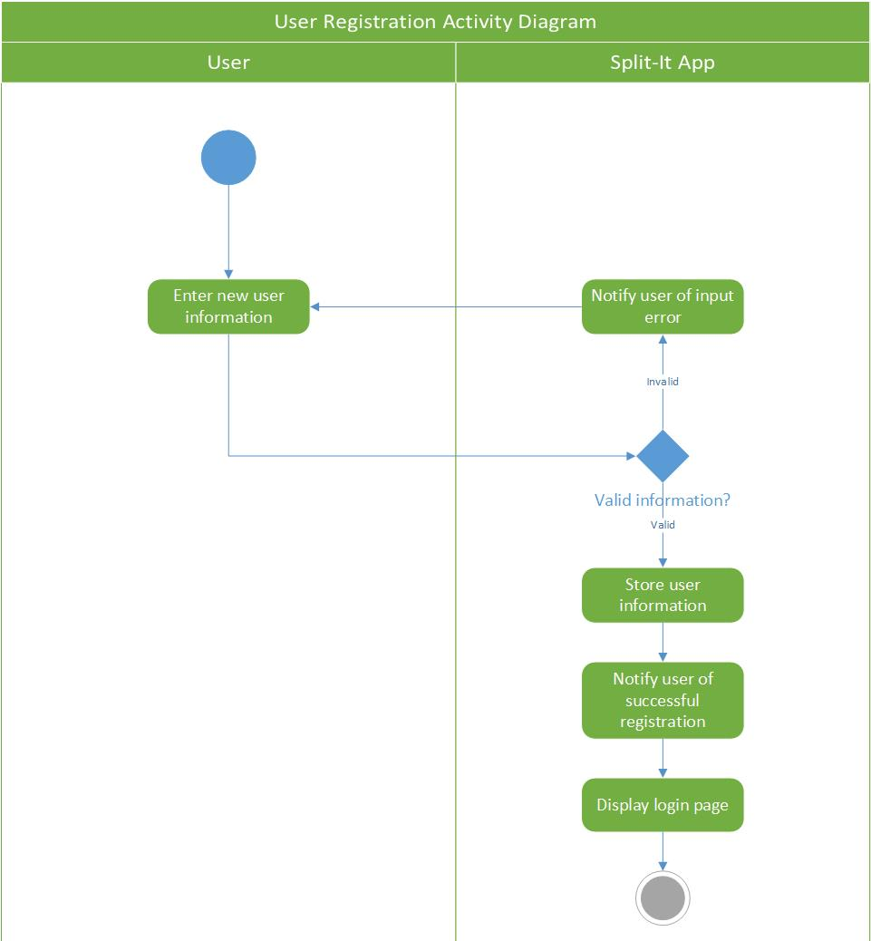
Activity Diagrams:
Notes:
Logan

Slide 8
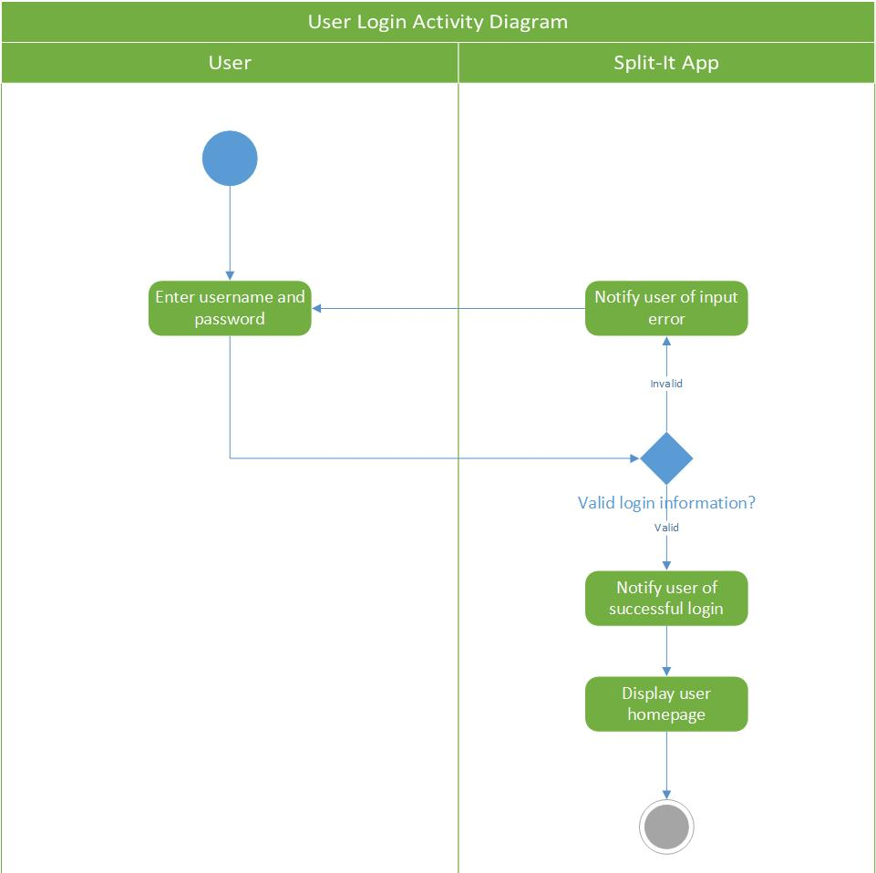
Activity Diagrams:
Notes:
Logan

Slide 9
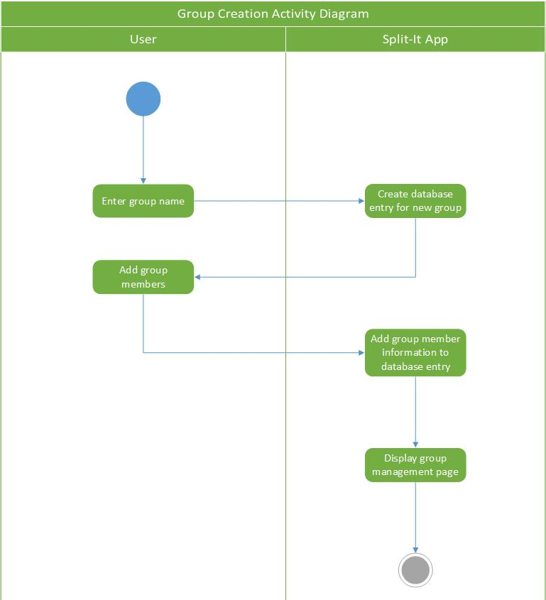
Activity Diagrams:
Notes:
Brian

Slide 10
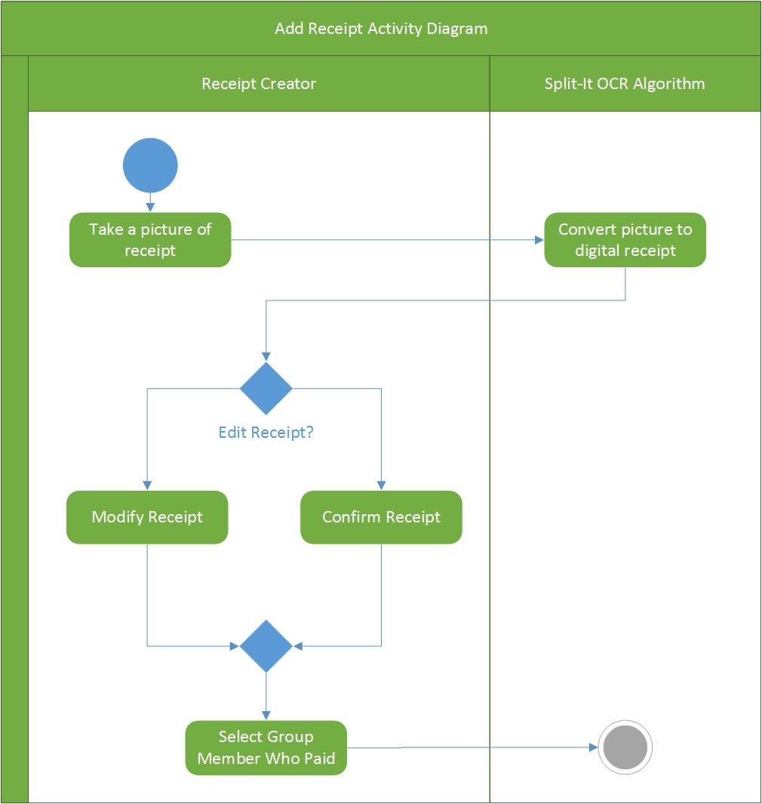
Activity Diagrams:
Notes:
Tzofi

Slide 11
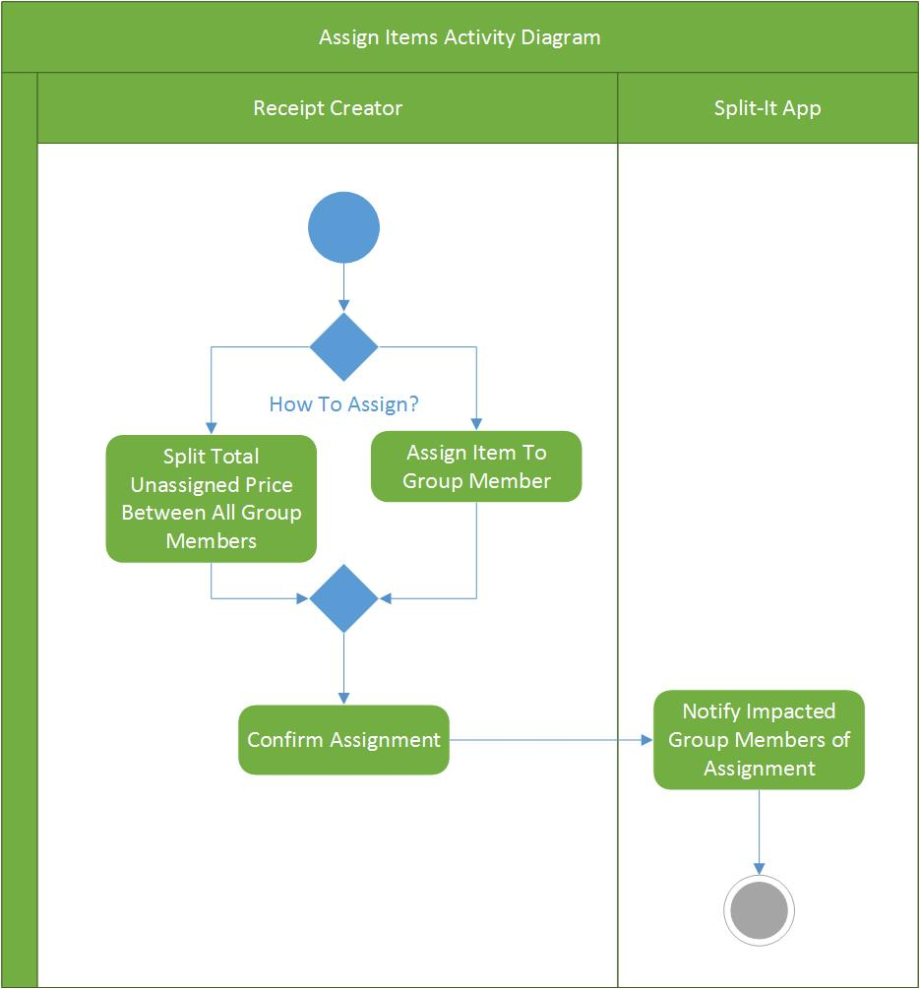
Activity Diagrams:
Notes:
Tzofi

Slide 12
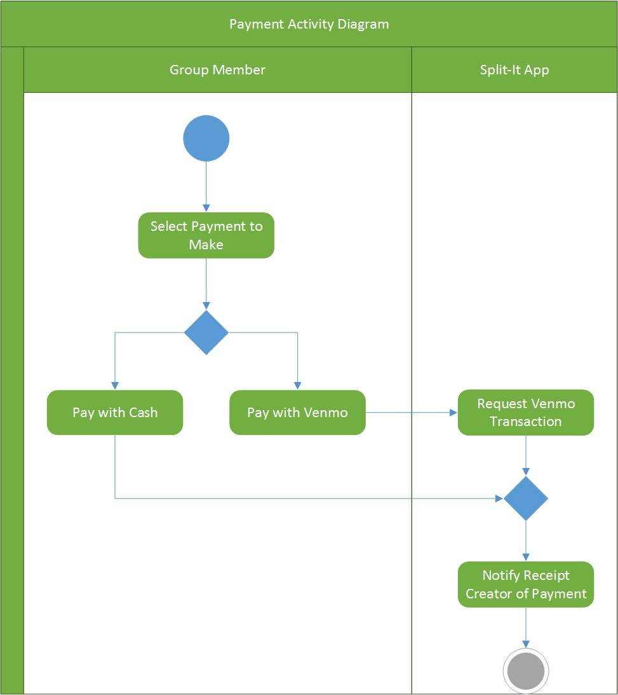
Activity Diagrams:
Notes:
Tzofi

Slide 13
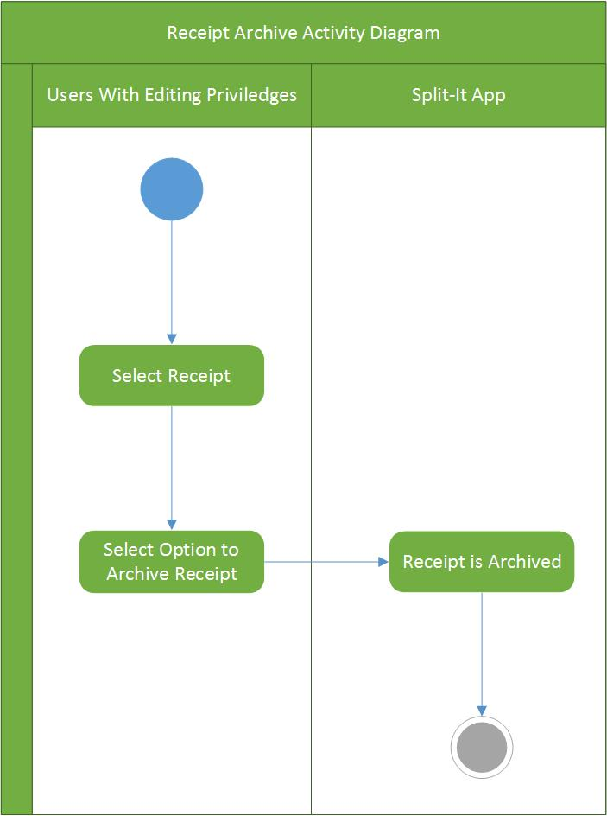
Activity Diagrams:
Notes:
Tzofi

Slide 14
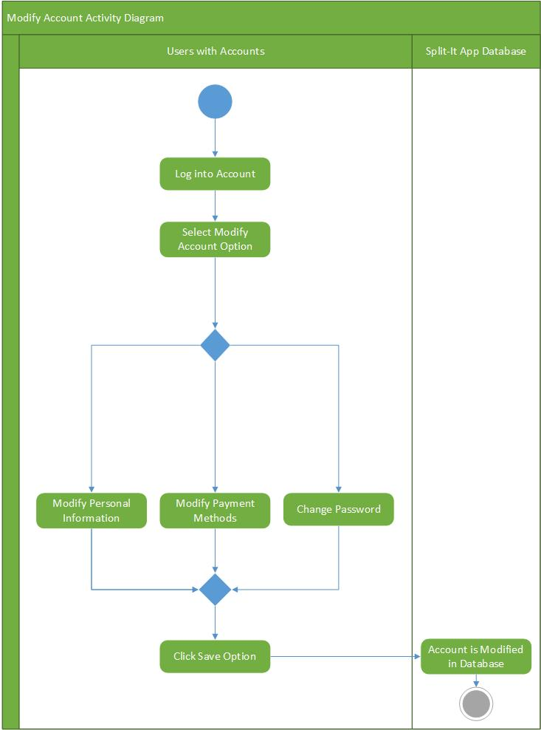
Activity Diagrams:
Notes:
Charlie

Slide 15
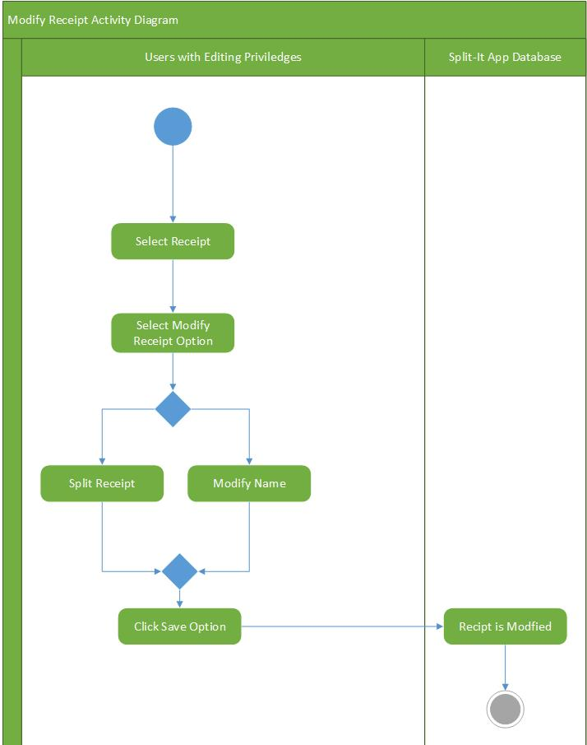
Activity Diagrams:
Notes:
Charlie

Slide 16
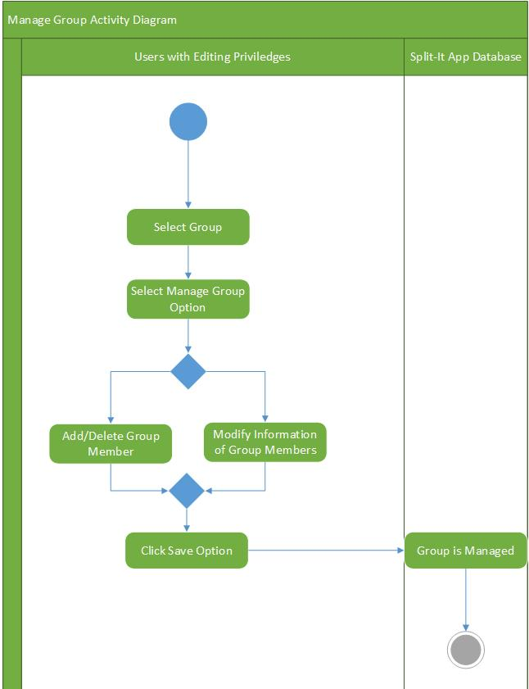
Activity Diagrams:
Notes:
Charlie

Slide 17
Features
Required | Possible | Future Work
Capture image of receipt | Parse text data for necessary information | Payment via Venmo
Convert image to text | Manage consumers and groups
Perform calculations to split prices | Account management
Account creation | Add/change items and prices manually
Notes:
Charlie

Slide 18
Potential Risks
BlinkReceipt API doesn’t work how we assume it will.
Backend integration and synchronization across multiple devices and accounts.
Time crunch with only about a month to code the app.
Notes:
Tzofi

Slide 19
Summary
Currently on track, but need to experiment more with the BlinkReceipt API.
Need to make UI decisions.
Next Step: Get remaining documentation done as soon as possible, and then start actual implementation.
Notes:
Logan

